Slide 1
How To Use Java from the Command Line
CMSC 203 / 204

Slide 2
Options
You have basically two options for building and compiling Java applications:
Command Line
Integrated Development Environment (IDE)
Eclipse
NetBeans
… others
Here are the basics for getting your computer set up for command-line Java

Slide 3
Step 1
Download Java SE SDK (version 7 or 8).
If you already have it installed, it will likely be found at C:\Program Files\Java\jdk1.8.0_25\bin or something similar.
If not, download it from the following site: http://www.oracle.com/technetwork/java/javase/downloads/jdk8-downloads-2133151.html

Slide 4
Step 2
Check if you can access java.exe and javac.exe
Launch a command console
Windows 7: above the start button, type cmd in the window
Windows 8 or 10: search for “command prompt”
Enter the command “java -version” at the prompt
If you get something like:
Java version “1.8.0_25”
Java™ SE Runtime Environment (build 1.8.0_25-b18)
and if this is the SDK you just installed, then you are pointed to that version of Java
If not, go to the next slide
Enter the command “javac” at the prompt
If you get something like the following, go to the following slide:
“javac is not recognized as an internal or external command…“
If you get a list of options, you are connected to the SDK

Slide 5
Step 3 (if you cannot access java or javac)
Problem: your computer needs to know where to find …
the JDK, and
your source code (*.java files) at the same time
Solution: There are two ways to connect to the JDK.
Change your PATH environment variable to include the location of the JDK/bin directory.
OR
Include the location of the JDK or the java file in your console command.

Slide 6
Step 3 (solution #1)
Change your PATH environment variable to include the location of the JDK/bin directory.
CAUTION: Be very careful not to wipe out the whole PATH environment variable – it may prevent you from doing anything in Windows, including launching it. Save a copy of PATH in case you need to fix it.
Windows 7:
Right-click on the computer icon on the desktop (or in the start menu) and select “Properties”
Select “Advanced System Settings”
Go to 3 below…
Windows 8:
In Windows Search, select Settings (Windows Key + W) and search for “Environment variables”.
Select “Edit system environment variables” (requires admin privileges)
Go to 3 below…
You will get the same window on either OS. Then…
In the resulting window, select the Advanced tab and the Environment Variables button
Locate the Path variable, and edit it. Add to the end of the path a semi-colon and the complete path to the SDK bin directory, for example:
C:\Program Files\Java\jdk1.7.0_25\bin

Slide 7
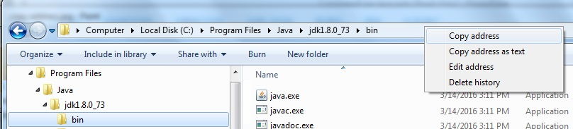
Step 3 (solution #2, pg 1 of 2)
Include the location of the JDK or the java file in your console command.
In a “Windows Explorer” (Windows) or other file browser, find the JDK.
A standard configuration places the JDK in C:\Program Files\Java\jdk1.8.0_73.
Copy the path to jdk\bin
Write it down, or
In the address bar, right-click and “copy address”
Paste the address to the jdk into the console, add javac, and put quotes around it
Add the *java file (with its path if needed)

Slide 8
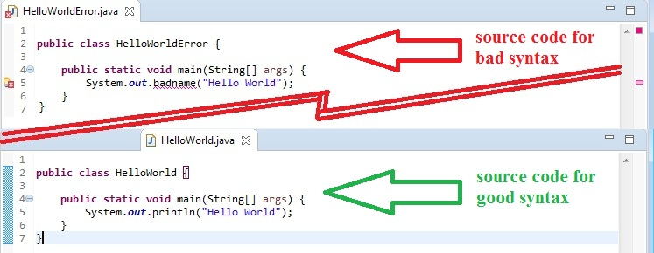
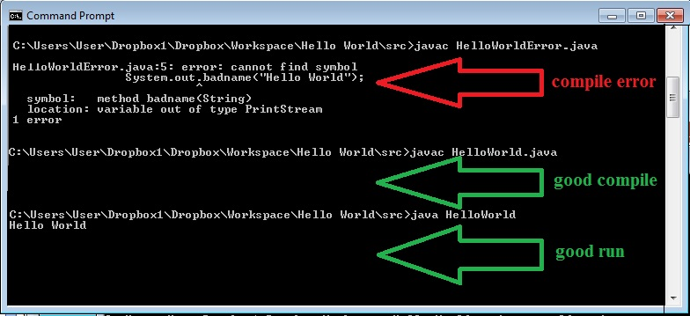
Step 3 (solution #2, pg 2 of 2)
Hints:
In the cmd console, use “DOS” commands
cd <path> - “Change Directory” to <path>
cd .. - “Change up one directory”
dir - “List the contents of the current directory”
Use up-arrow (or down-arrow) to retrieve previous (or later) commands
Example session:

Slide 9
Step 4 (once you have access to java & javac)
Create a simple text test program (e.g., HelloWorld.java)
Launch a command console (see Step 2)
Using DOS-style commands (e.g., cd and dir) navigate to the directory where you saved HelloWorld.java
To change directory into a directory named myDir, use ‘cd myDir’
To change directory up one level, use ‘cd ..’
To list the contents of the current directory, use ‘dir’
Compile
At the prompt, enter:
javac HelloWorld.java
Fix any syntax errors in a text editor, recompile
Run the application
At the prompt, enter:
java HelloWorld
NOTE that you do not include any suffix – the JVM runs the program HelloWorld.class

Slide 10
More information…
If you want more information about command-line processing in Java, you can go to the following link:
https://www.lynda.com/Java-tutorials/Exploring-command-level-programming/375490/415238-4.html

